Slide 1

Capstone Project 1
MANUFACTURING EQUIPMENT OUTPUT PREDICTION WITH LINEAR REGRESSION
Team Members
T170800533: Yash Bangar
T170800536: Vishnu Jagtap
T170800531: Abuzar Maksud Allam Shaikh

Slide 2
Table of Contents
Problem Statement
Overview of the Project
Data Loading & Understanding
Exploratory Data Analysis
Data Preprocessing & Feature Engineering
Model Building & Training
Model Evaluation & Performance Analysis
Key Insights & Recommendations
FastAPI Deployment
Docker Deployment
Conclusion

Slide 3
Problem Statement
You are working as a data analyst for a manufacturing company that operates injection molding machines to produce plastic components. The company wants to optimize production efficiency by predicting the hourly output (number of parts produced per hour) based on various machine operating parameters. Your task is to build a linear regression model that can predict machine output using factors like temperature, pressure, cycle time, and material properties. This will help the production team optimize machine settings, plan production schedules, and identify when machines are underperforming.

Slide 4
Overview of the Project
This project predicts the hourly output (Parts_Per_Hour) of injection molding machines using linear regression, based on operating parameters like temperature, pressure, cycle time, and material properties.
The dataset has 1,000 hourly records with numerical and categorical features, including engineered features such as Efficiency_Score, Temperature_Pressure_Ratio, Total_Cycle_Time and Machine_Utilization.
A complete ML pipeline is built: timestamp processing, median imputation, one-hot encoding, standard scaling, an 80/20 train-test split and Linear Regression training.
On the test set the model achieves R² = 0.906, RMSE = 3.51 and MAE = 2.72 parts/hour; the model, scaler and feature list are saved for deployment.
The model is served through a FastAPI prediction endpoint and containerized with Docker, helping optimize machine settings, improve scheduling and detect underperforming machines.

Slide 5
Data Loading
Dataset: manufacturing_dataset_1000_samples.csv, loaded with pandas
Size: 1,000 hourly records × 19 columns (Timestamp, 17 features, target)
Target: Parts_Per_Hour (parts produced per hour)
Missing values: 20 each in Material_Viscosity, Ambient_Temperature and Operator_Experience
Feature groups:
Machine settings: Injection_Temperature, Injection_Pressure, Cycle_Time, Cooling_Time
Material & environment: Material_Viscosity, Material_Grade, Ambient_Temperature
Human & equipment: Machine_Age, Machine_Type, Operator_Experience, Maintenance_Hours
Context: Shift, Day_of_Week, Timestamp
Engineered: Temperature_Pressure_Ratio, Total_Cycle_Time, Efficiency_Score, Machine_Utilization

Slide 6
Data Exploration & Understanding
Dataset Source & Size: manufacturing_dataset_1000_samples; 1,000 records, 19 columns. Target Parts_Per_Hour ranges from 5.0 to 68.6 (mean ≈ 29.3).
Machine Parameters: Injection_Temperature (180–300 °C), Injection_Pressure (80–150 bar), Cycle_Time (16.3–60 sec), Cooling_Time (8–19.9 sec).
Material & Environmental Features: Material_Viscosity (104.6–1000), Ambient_Temperature (18–28 °C).
Equipment & Operator Features: Machine_Age (1–15 years), Operator_Experience (1–120 months), Maintenance_Hours (26–500 hours).
Categorical Features: Shift (Day / Evening / Night), Machine_Type (Type_A / B / C), Material_Grade (Economy / Standard / Premium), Day_of_Week (Monday–Sunday).

Slide 7
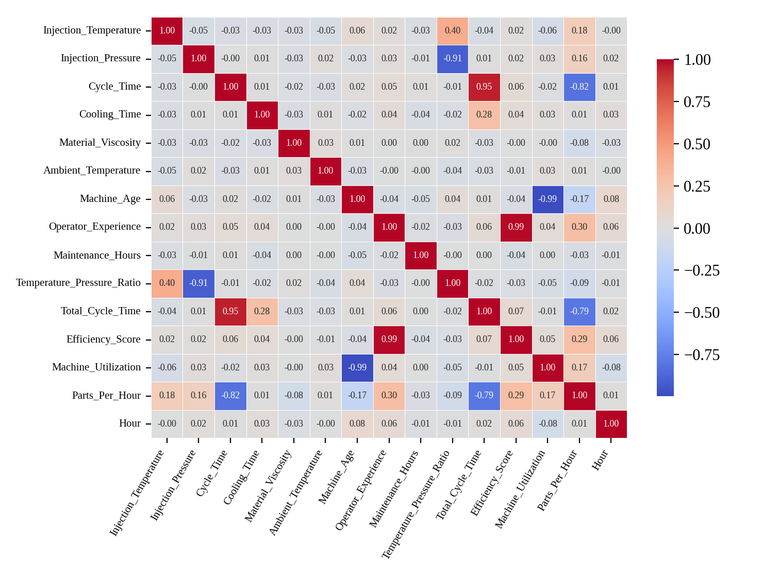
Exploratory Data Analysis: Correlation Matrix
Cycle_Time (r = −0.82) and Total_Cycle_Time (−0.79) are the strongest drivers of output
Operator_Experience (+0.30) and Efficiency_Score (+0.29) lift output; Machine_Age (−0.18) lowers it
Engineered features are highly correlated with their sources (e.g. Cycle_Time vs Total_Cycle_Time 0.95, Operator_Experience vs Efficiency_Score 0.99)
Cooling_Time and Ambient_Temperature show almost no direct correlation with output

Slide 8
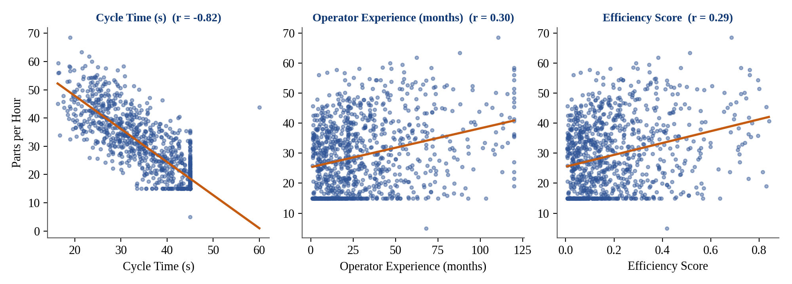
Exploratory Data Analysis: Scatter Plots
Shorter cycle times → higher output (strong negative trend, r = −0.82)
Higher operator experience → better performance (r = +0.30)
Higher efficiency score → higher output (r = +0.29)
Day shift, Type_A machines and Premium material grade have the highest average output

Slide 9
Data Preprocessing & Feature Engineering
1. Timestamp Processing:
Extracted Hour from Timestamp as a new time-based feature
Dropped the raw Timestamp column
2. Handling Missing Values:
Material_Viscosity, Ambient_Temperature and Operator_Experience had 20 missing values each
Filled with the median of each column
3. Encoding Categorical Variables:
One-Hot Encoding (drop_first=True) on Shift, Machine_Type, Material_Grade, Day_of_Week → 26 model features
4. Splitting Data:
80% training (800 rows) and 20% test (200 rows) with random_state=42
5. Scaling Features:
StandardScaler fitted on training data only, then applied to both sets to avoid data leakage

Slide 10
Model Building & Training
1. Linear Regression Model:
Fits a straight-line relationship between the 26 input features and Parts_Per_Hour
Implemented with scikit-learn LinearRegression
2. Why Linear Regression:
Coefficients are easy to interpret, showing how each setting changes output
Fast and lightweight, which suits real-time API deployment
3. Training the Model:
Trained on 800 scaled training samples
Tested on 200 unseen test samples
4. Saving Artifacts (joblib):
linear_regression_model.pkl, scaler.pkl and feature_names.pkl
5. Reproducibility:
Fixed random_state=42 so the split and results can be repeated

Slide 11
Model Evaluation & Performance Analysis
Metric | Meaning | Test Value
R² Score | Share of output variance explained | 0.9056
MSE | Mean squared error (large errors punished) | 12.3150
RMSE | Error in parts/hour units | 3.5093
MAE | Average absolute error | 2.7154
The model explains about 90.6% of the variation in hourly output
Typical error is about 2.7 parts/hour, roughly 9% of the average output (29.3)
86% of test predictions fall within ±5 parts/hour of the actual value
Train R² (0.924) is close to test R² (0.906), so the model is not overfitting
RMSE is slightly above MAE: a few larger errors occur at the low-output end, because 19% of records have actual output floored at exactly 15 parts/hour
Classification metrics (precision, recall, F1) do not apply to a regression target; RMSE, MSE, MAE and R² are used

Slide 12
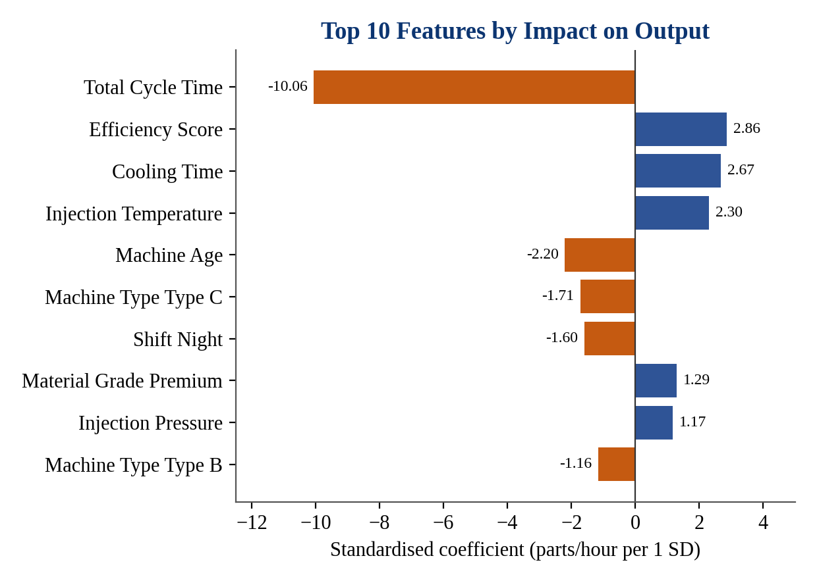
Key Insights & Recommendations
Insights
Total cycle time is the dominant driver: +1 SD lowers output by about 10 parts/hour
Older machines, Type_C machines and the Night shift produce less
Higher efficiency score, injection temperature and Premium material raise output
Recommendations
Reduce cycle time first to gain the most output
Prioritize maintenance or replacement of older machines
Train less experienced operators and review Night-shift practices
Flag machines running well below predicted output as underperforming
Coefficients from the standardized model. Several features are correlated with each other, so read individual coefficients with care.

Slide 13
FastAPI Deployment
FastAPI service "Manufacturing Output Prediction API" loads the saved model, scaler and feature list at startup.
POST /predict accepts a JSON body with 18 inputs, validated by a Pydantic MachineData schema.
Prediction pipeline: JSON → DataFrame → one-hot encoding → align to training features → StandardScaler → model.
Response: Predicted_Parts_Per_Hour, rounded to 2 decimals. Swagger docs are available at /docs.
Request (sample record):
{"Injection_Temperature": 221.5, "Injection_Pressure": 123.7, "Cycle_Time": 40.9,
"Cooling_Time": 11.0, "Material_Viscosity": 144.9, "Ambient_Temperature": 24.0,
"Machine_Age": 13.0, "Operator_Experience": 5.5, "Maintenance_Hours": 42,
"Shift": "Evening", "Machine_Type": "Type_A", "Material_Grade": "Economy",
"Day_of_Week": "Friday", "Temperature_Pressure_Ratio": 1.79, "Total_Cycle_Time": 51.8,
"Efficiency_Score": 0.036, "Machine_Utilization": 0.107, "Hour": 17}
Response: {"Predicted_Parts_Per_Hour": 19.94} (actual value: 18.6)

Slide 14
Docker Deployment
Create a Dockerfile – Uses the python:3.10-slim base image, sets /app as the working directory and containerizes the FastAPI application.
Prepare requirements.txt – Lists the dependencies: fastapi, uvicorn, pandas, scikit-learn, joblib and pydantic.
Copy app and model artifacts – Packages app.py together with linear_regression_model.pkl, scaler.pkl and feature_names.pkl.
Expose and run – Exposes port 8000 and starts the server with: uvicorn app:app --host 0.0.0.0 --port 8000.
Build and run – docker build -t manufacturing-api . then docker run -p 8000:8000 manufacturing-api

Slide 15
Conclusion
We built a Linear Regression model to predict the hourly output of injection molding machines from operating parameters such as temperature, pressure, cycle time, material properties, machine age and operator experience. The project covered data loading, exploratory data analysis, preprocessing (median imputation, one-hot encoding, scaling) and model training, followed by evaluation with R² (0.906), MSE (12.32), RMSE (3.51) and MAE (2.72). Insights from the model identified cycle time as the key factor affecting production and gave actionable recommendations for machine settings, maintenance and operator training. The trained model is served through a FastAPI backend and containerized with Docker using a Dockerfile and requirements.txt for production-ready deployment. Overall, the project demonstrates an end-to-end data science workflow with practical industrial applications.

Slide 16
Any Queries ???

